Slide 1
Coffee Hub By Akhil Montrose
Aim of this presentation is to illustrate the steps in designing a web application for a coffee shop.
Name of Supervisor: Dr. Ken Sooknanan

Slide 2
Introduction
This presentation will briefly discuss:
Problem and Solution
Background Information
The methods chosen in solving the problem.
Sub-components.
Project Timeline & Anticipated Risks.

Slide 3
Problem the business faces
CoffeeHub, like many businesses in Trinidad & Tobago, have suffered greatly because of the pandemic.
Because of this, they haven’t been able to perform as they would like.
Because their business is centred around customers being at the establishment (especially at a time that they couldn’t), they have been hit hard.

Slide 4
Solution
Design a web application for the business.
The web application will be divided into two sections (customers & employees/Admin).
Customer should be able to perform the same actions that they would perform if they were actually ordering a coffee at the business.
Employees/Admin should be able to perform all the normal functions like managing orders etc.

Slide 5
Background Information – Current System
Coffeehub is an coffee house that sells coffee and other items on their menu. The company currently uses a file based system. Due to this, they would encounter many problems.
Documents would be displaced.
Paper clutter
Files destroyed
Very limited to sharing data
Security problems would occur because of misplaced files.
Data Redundancy

Slide 6
Background Information: Existing Systems
There are two other reputable coffee establishments in Trinidad and Tobago:
StarBucks
Rituals
They both have web applications but have different functionalities.

Slide 7
Comparison: Rituals/Starbucks/CoffeeHub
 | Rituals | Starbucks | CoffeeHub
Web Application | Yes | Yes | Yes
Membership | Yes but not necessary | No | Yes
Browse online menu | Yes | Yes | Yes
Order items | Yes | Yes (Specific locations) | Yes
Customer can pick-up | Yes | Only at specific locations | Yes
Android/IOS Apps from their respective stores | Yes | No | No
Offers Delivery | Yes | Drive Thru | Yes

Slide 8
Methodology: Main Requirements
Create a system that both customers/employees can access online.
Must be able to view all of the coffee available on the menu.
Customers must be able to login/signup
Customers must be able to order item(s) available from the website.
Employees mush be able to manage all the services of the application.
Customers should be able to view the status of their orders on the website.

Slide 9
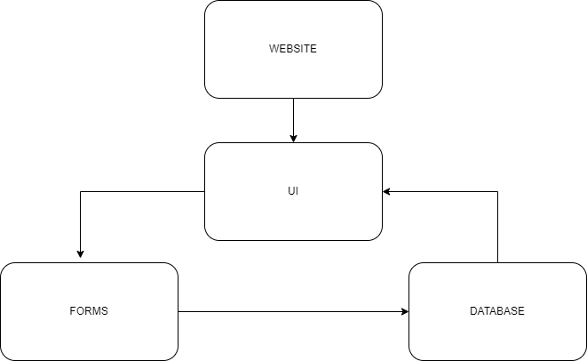
Sub-components

Slide 10
Methodology: Website
The website will contain multiple pages that will allow users to directly/indirectly interact with the other sub-components.:
User Interface (HTML/CSS)
Sign up/login (Forms).
Give authorized users the ability to create/display/delete information from the database. (Using PHP to fetch information from the database)

Slide 11
Methodology: Forms
The forms in this website will be used to input data for:
User information when signing up (customer/employee).
When logging in.
When the admin is managing items to be displayed on the menu.
Validation will be done using HTML as well as JavaScript.
PHP will be used to process the data entered in the forms to the database.

Slide 12
Methodology: Database
The database that will be utilized for this application is SQL.
This database will be storing information on:
User information (customer/employee)
Items served on the menu.
Orders placed by customers.

Slide 13
Methodology: Waterfall Model
The reason why the Waterfall Model was chosen are:
This model is simple and very easy to understand.
Phases in this model is processed one at a time.
The processes/actions are well documented.
It works for smaller projects where the requirements are well understood.

Slide 14
Project Timeline
The project timeline is expected to start around September 2021 and to finish around May 2022.
The project will be broken up into two parts, phase 1 and phase 2.
Phase 1:
September 2021 – January 2022
Phase 2:
January 2022- May 2022

Slide 15
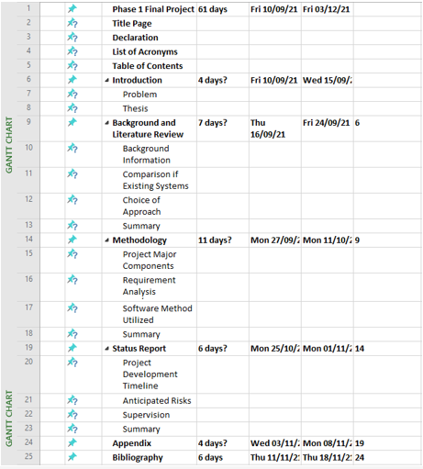
Project Timeline: Phase 1 Gantt Chart

Slide 16
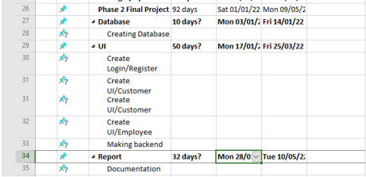
Project Timeline: Phase 2 Gantt chart

Slide 17
Anticipated Risks
Time: Due to unforeseen circumstances some of the functionalities may not be able to be completed.
Other engagements: The amount of work that may have to be completed while completing this project may be overwhelming.

Slide 18
The END

